Slide 1
Formal Languages and Compiler Design
Simona Motogna

Slide 2
Why?
Formal Languages
Compiler Design
FLCD
Historical reasons
Be a better programmer
Performant algorithms

Slide 3
Organization Issues
Course – 2 h/ week
Seminar – 2h/week
Laboratory - 2 h/week
PRESENCE IS MANDATORY
10 presences – seminar
12 presences - lab

Slide 4
Most interesting stuff for students
Moodle:
All course resources
Homeworks
Assignments
Labs
Points / grades
MsTeams – communication chanel

Slide 5
Minimal Conditions to Pass
Minimum 10 presences at seminar
Minimum 12 presences at laboratory
Minimum grade 6 at lab
Minimum grade 5 at final exam

Slide 6

Final grade
60% final exam
+
30% lab
+
10% seminar
Bonus

Slide 7
Lab work
10 laboratory tasks
!!! Must be completed and loaded during lab hours
Weighted grades:
Lab grade
Bonus points:
“awesome” solutions
Extra work

Slide 8



I wish …
Effective communication
Interactive experience
Learning fun

Slide 9
References
See fișa disciplinei

Slide 10
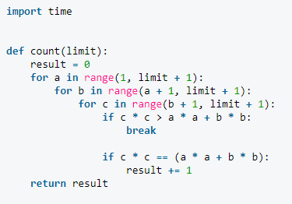
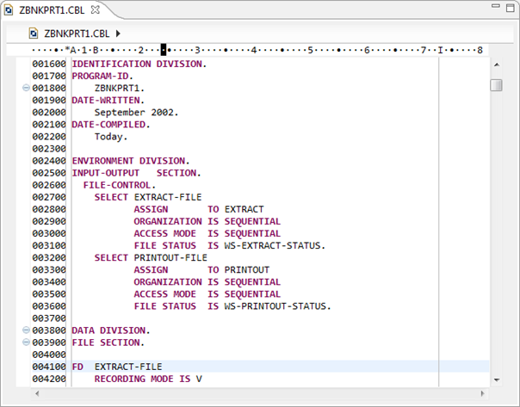
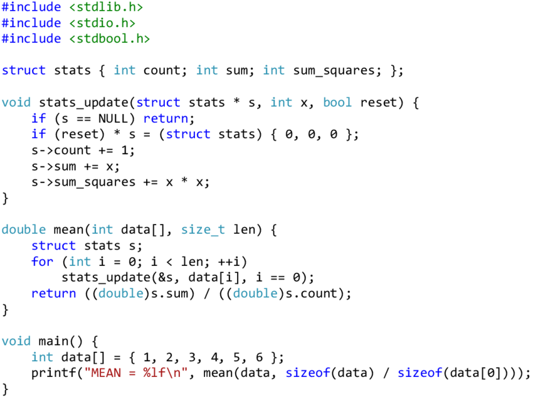
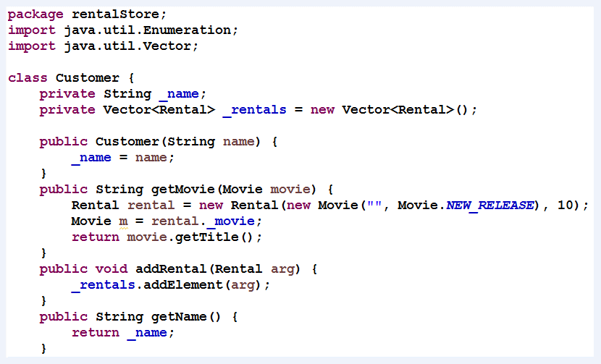
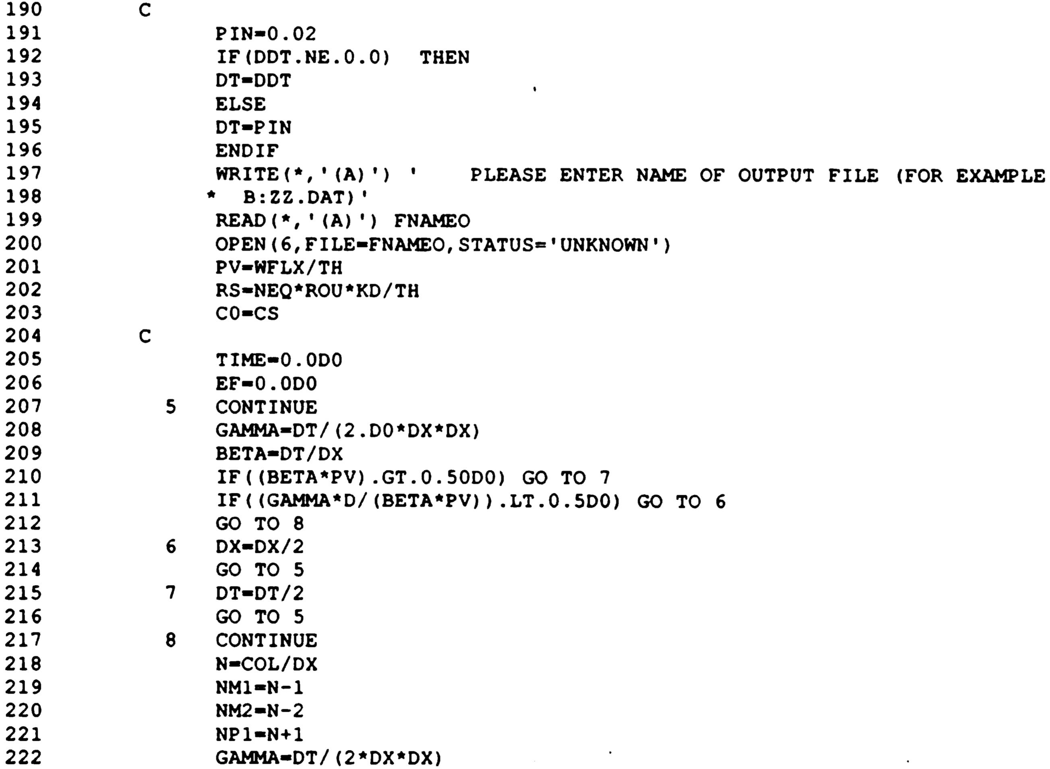

Slide 11
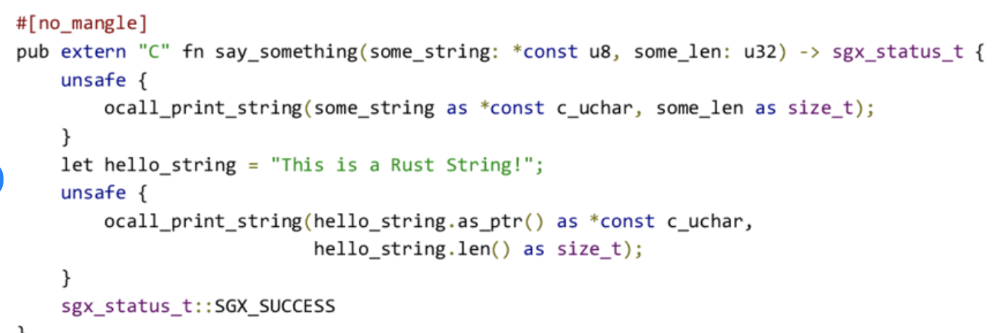
Rust
According to a StackOverflow survey: “Rust is considered to be one of the fastest-growing programming languages and has been ranked as the most liked language by its users”
code security to avoid memory leaks and other undefined behaviors
It is overly verbose, convoluted, hard to read, slow to compile, BUT high performance along with safety guarantees

Slide 12
What is a compiler?
Interpreter?
Source code / program
Object code / program
Compiler
Assembler?

Slide 13
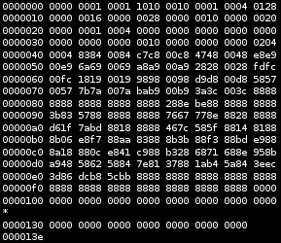

Slide 14
A little bit of history …
Java
1995
J. Gosling
C
1969 - 1973
D. Ritchie
Pascal
1968 - 1970
N. Wirth
Lisp
1962
McCarthy
Fortran
1954-1957
Backus

Slide 15
Structure of a compiler
Take notes!
analysis
Error handling
Source code/ program
Scanning (lexical analysis)
Parsing (syntactical analysis)
Semantic analysis
Intermediary code generation
Intermediary code optimization
Object code generation
Tokens & ST
Syntax tree
synthesis
Adnotated syntax tree
Symbol Table management
Intermediary code
Object code / program
Optimized intermediary code

Slide 16
Chapter 1. Scanning
Definition = treats the source program as a sequence of characters, detect lexical tokens, classify and codify them
INPUT: source program
OUTPUT: PIF + ST
Algorithm Scanning v1
While (not(eof)) do
detect(token);
classify(token);
codify(token);
End_while

Slide 17
Detect
Take notes!
Separators => Remark 1)
Look-ahead => Remark 2)
I am a student.I am Simona
if (x==y) {x=y+2}

Slide 18
Classify
Classes of tokens:
Identifiers
Constants
Reserved words (keywords)
Separators
Operators
If a token can NOT be classified => LEXICAL ERROR

Slide 19
Codify
May be codification table
OR
code for identifiers and constants
Identifier, constant => Symbol Table (ST)
PIF = Program Internal Form = array of pairs
pairs (token, position in ST)
identifier, constant

Slide 20
Algorithm Scanning v2
While (not(eof)) do
detect(token);
if token is reserved word OR operator OR separator
then genPIF(token, 0)
else
if token is identifier OR constant
then index = pos(token, ST);
genPIF(token, index)
else message “Lexical error”
endif
endif
endwhile
a=a+b
FIP
(id,1)
(=,0)
(id,1)
(+,0)
(id,2)
ST
a
b

Slide 21
Remarks:
genPIF = adds a pair (token, position) to PIF
Pos(token,ST) – searches token in symbol table ST; if found then return position; if not found insert in SR and return position
Order of classification (reserved word, then identifier)
If-then-else imbricate => detect error if a token cannot be classified

Slide 22
Example (sem?)
https://babeljs.io/docs/en/
https://www.antlr.org/ and https://github.com/antlr/antlr4
https://www.programiz.com/python-programming/online-compiler/
https://www.w3schools.com/python/python_compiler.asp

